Slide 1
Cloud and App based smart agriculture management
Project Guide
Mr. Manu Raju
Assistant Professor
B.Tech.,M.Tech.
Project Members
Chandru K
Fayazdheen J
Hammad Ahamed R

Slide 2
Contents
Introduction
Abstract
Objective
Literature survey
Proposed method
Block Diagram
Conclusion

Slide 3
Abstract
Now a days there is a soaring use of technology into the field of agriculture eliminate human efforts and to automate things, whenever and wherever possible. Among these tools and technologies which contribute and aid in advanced agriculture, IoT can be big game changer with its unique potentials of letting the devices interact among themselves. Most tools available are helping takeover the physical efforts and the technologies help to monitor and analyse the necessities. But there isn't any prominent, and customisable and globally deployable solution for both monitoring and controlling the devices. This project solves that specific problem by providing easy and standardised interfacing and the ability to remotely administer the ecosystem.

Slide 4
Objective
There are lot of services available to help us monitor the sensors with the IoT technology and few tools and machineries to aid the humans with their physical labour efforts. Yet, there isn't any service or platform to remotely administer to perform customised action for the same. This project attempts to provide a facility to both live monitoring and administration to provide the user with remote access control to mange their agricultural ecosystem.

Slide 5
Literature Survey
Title of the paper | Journal Published | Inference | Disadvantage
IOT BASED MONITORING SYSTEM IN SMART AGRICULTURE | Prathibha S R1, Anupama Hongal 2, Jyothi M P3 1, 2, 3 Assistant Professor, Department of Electronics and Communication Engineering | The farmers are still using traditional methods for agriculture, which results in low yielding of crops and fruits. So the crop yield can be improved by using automatic machineries | System should be improved by adding several modern techniques like irrigation method, solar power source usage.
The Study and Application of the lOT Technology in Agriculture | Ji-chun Zhao Institute of Information on Science and Technology of Agriculture Beijing Academy of agriculture and forestry Sciences Beijing, China | Agriculture greenhouse production environment measurement and control system is an example of IoT technology application in agriculture. The critical temperature, humidity and soil signals are collected real-time in the agriculture production process | Didn't Have a dedicated software for monitor the fetching values

Slide 6
Proposed Method
connect multiple monitoring sensor with microcontrollers
providing the micro controllers with connectivity to the internet
make the microcontroller push the fetched data to a backend server
making the backend, an accessible API- building an Android app for this application.
Fetch the data from the backend through the app
Present the fetched data and proving the Monitoring feature
Making the microcontroller to listen for inputs with the help of web sockets
Providing controls inside the app for its use to perform remote actions

Slide 7
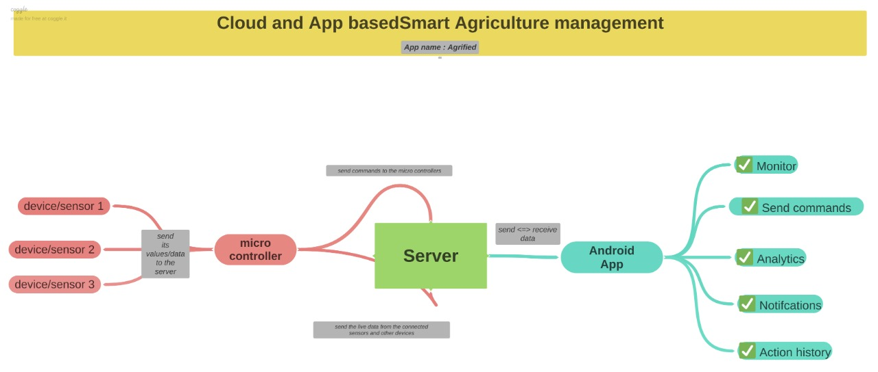
Block Diagram – Concept/Outline
Server | DB

Slide 8
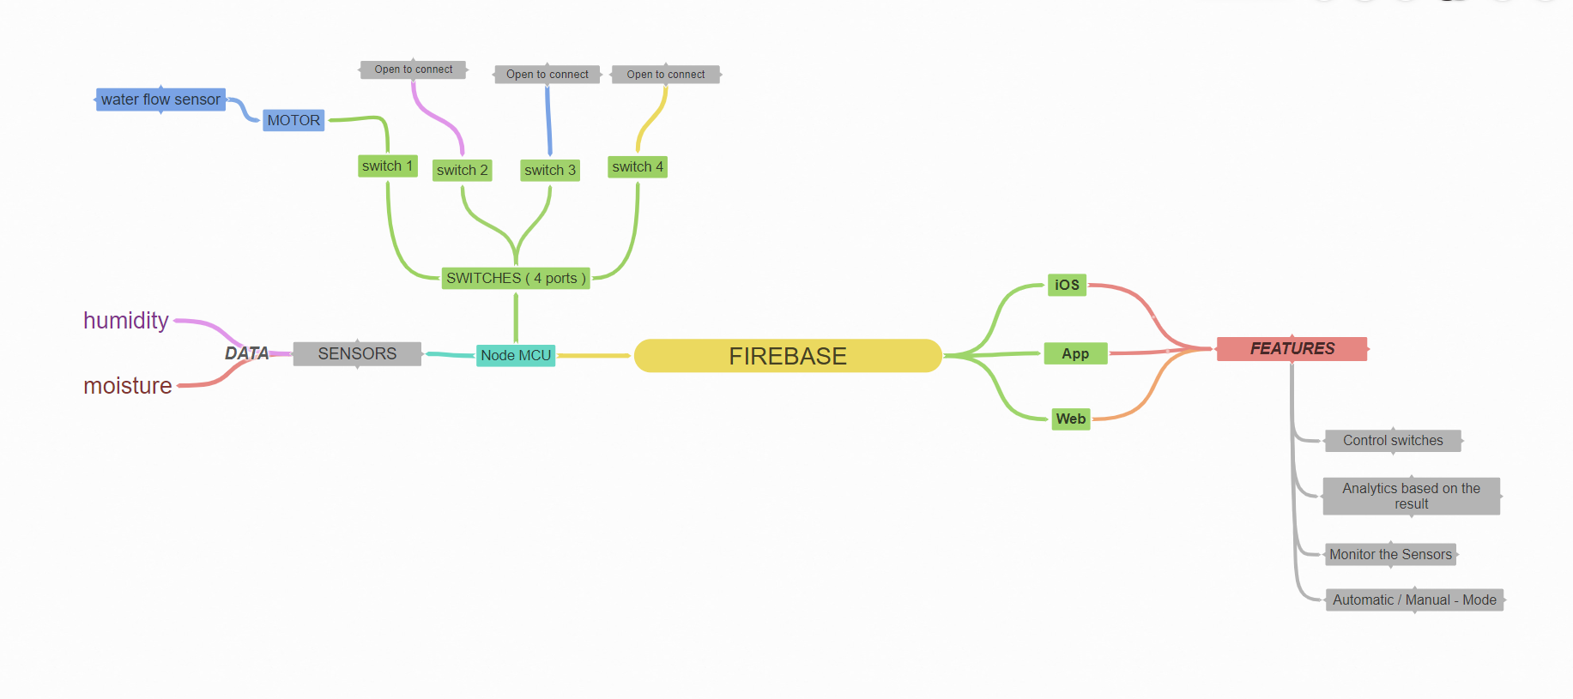
Block Diagram - Implementation

Slide 9



